Slide 1

School of Computing Science and Engineering
Course Code: BCS01T1001 Course Name: Data Analytics (Excel and Tableu)
Unit – 2
Manipulation of Excel Data
Faculty Name: Mr. Soumalya Ghosh Program Name: B.Tech CSE

Slide 2
Objectives
Functions in Excel

Slide 3
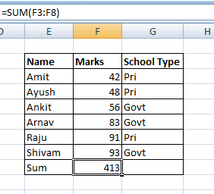

Software process and Process Models
Sum : MS Excel
Sum()
It is the summation all values in any particular row or column
Select any particular block where sum will be store
Write the formula for sum () in the formula bar
=SUM(first column/row : last column/row)
In this example it is –
SUM(F3:F8) and result is in block F9
Program Name: B.Tech –CSE
3

Slide 4
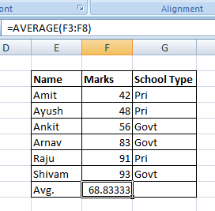
Software process and Process Models
Average : MS Excel
Average()
It is the average of all values in any particular row or column
Select any particular block where the average will be store
Write the formula for average () in the formula bar
=AVERAGE(first block column/row : last block column/row)
In this example it is –
AVERAGE(F3:F8) and result is in block F9
4

Slide 5
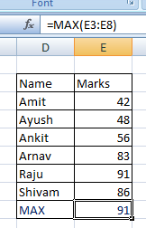
Max: MS Excel
MAX()
It will return the maximum value among all the values in any particular row or column
Select any particular block where the average will be store
Write the formula for MAX () in the formula bar
=MAX(first block column/row : last block column/row)
In this example it is –
MAX(E3:E8) and result is in block E9

Slide 6
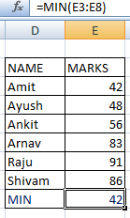
Min: MS Excel
MIN()
It will return the minimum value among all the values in any selected particular row or column
Select any particular block where the average will be store
Write the formula for MIN () in the formula bar
=MIN(first block column/row : last block column/row)
In this example it is –
MIN(E3:E8) and result is in block E9

Slide 7
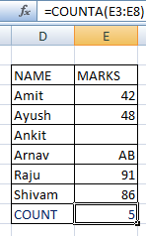
Count: MS Excel
COUNT()
It will return the count the total number of numerical values among all the values selected in any particular row or column
It will exclude the blank cell
Select any particular cell where the average will be store
Write the formula for COUNT () in the formula bar
=COUNT(first cell column/row : last cell column/row)
In this example it is –
COUNT(E3:E8) and result is in cell E9

Slide 8
Count: MS Excel
COUNTA()
It will return the count the total number of numerical values among all the values selected in any particular row or column
It will include the blank cell
Select any particular cell where the average will be store
Write the formula for COUNTA () in the formula bar
=COUNTA(first cell column/row : last cell column/row)
In this example it is –
COUNTA(E3:E8) and result is in cell E9

Slide 9
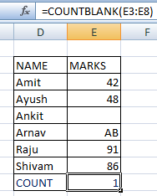
Count: MS Excel
COUNTBLANK()
It will return the count the total number blank cell among all the values selected in any particular row or column
It will include only the blank cell
Select any particular cell where the average will be store
Write the formula for COUNTBLANK () in the formula bar
=COUNTBLANK(first cell column/row : last cell column/row)
In this example it is –
COUNTBLANK(E3:E8) and result is in cell E9

Slide 10
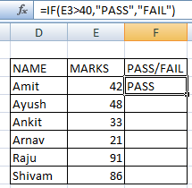
IF: MS Excel
IF()
The IF function runs a logical test and returns one value for a TRUE result, and another for a FALSE result.
For example,
to "pass" scores above 40:
Write the formula for IF () in the formula bar
=IF(E3>40,"Pass","Fail")

Slide 11
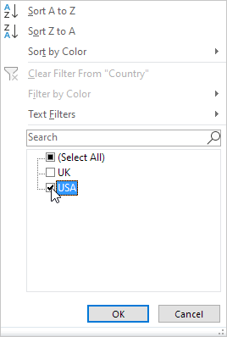
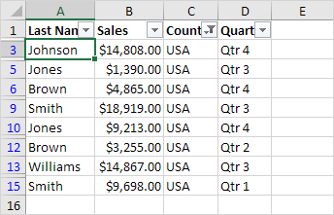
Filter
Click the arrow next to Country.
Click on Select All to clear all the check boxes, and click the check box next to USA.
Click OK
Result. Excel only displays the sales in the USA.

Slide 12
References
Borle, S. Introduction to Data Analysis Using Excel [MOOC]. Coursera. https://www.coursera.org/learn/excel-data-analysis

Slide 13
Questions?
Write your queries to
Soumalya.ghosh@galgotiasuniversity.edu.in​

Slide 14


